Slide 1


Paralleling Generator to the Grid
Dr. Norbert Doerry and Dr. John V. Amy Jr.
http://doerry.org/norbert/MarineElectricalPowerSystems/index.htm
© 2025 by Norbert Doerry and John Amy
This work is licensed via: CC BY 4.0 (https://creativecommons.org/)

Slide 2
Introduction
Connecting a generator to an existing power grid is one of the critical processes in operating a shipboard power system:
  One shipboard generator connecting to another shipboard generator
  One shipboard generator connecting to shore power (terrestrial grid)
Synchronization of the generator and the existing power grid is a prerequisite to making the connection. The generator and grid must match:
  Voltage magnitude
  Frequency
  Phase sequence
  Phase angle
Connecting a generator to an existing power grid without synchronization may lead to electrical surges, mechanical stress, blackout, or generator set damage.

Slide 3
Purpose of this video
Demonstrate how to parallel a generator to the grid.
  Start with grid and “ship service power” disconnected.
  Synchronize grid and “ship service power”
  Close the paralleling switches.

Slide 4
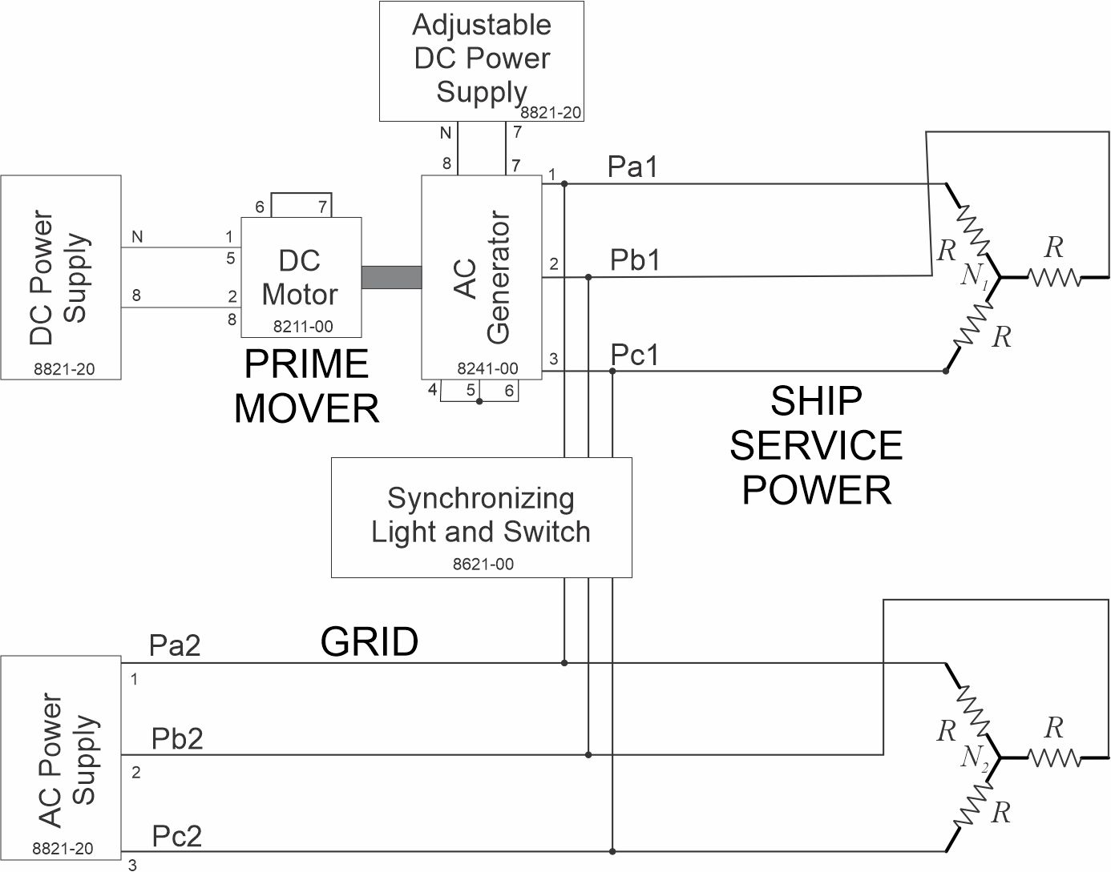
Schematic
Current Meters
- Output of AC Generator
- Output of AC Power Supply
- Synchronizing Light and Switch
Voltage / Frequency Meters
- Output of AC Generator
- Output of AC Power Supply
R = 300 Ω
V = 208 V (rms line to line)

Slide 5
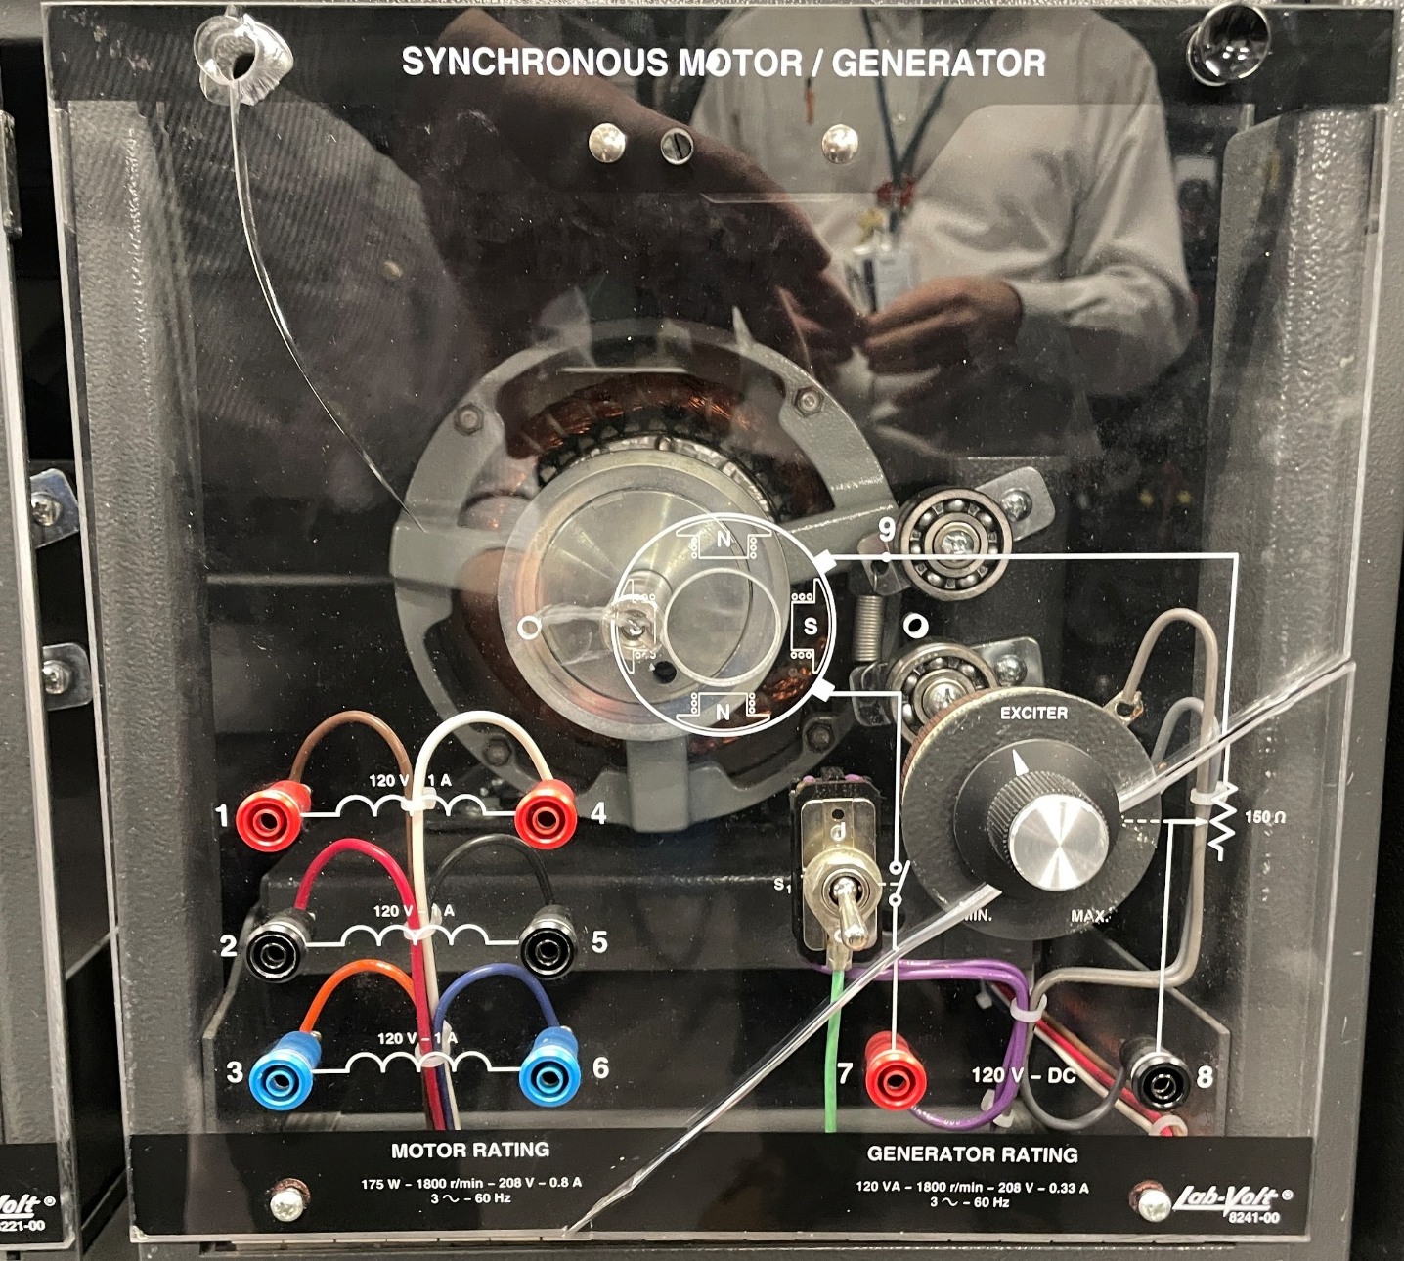
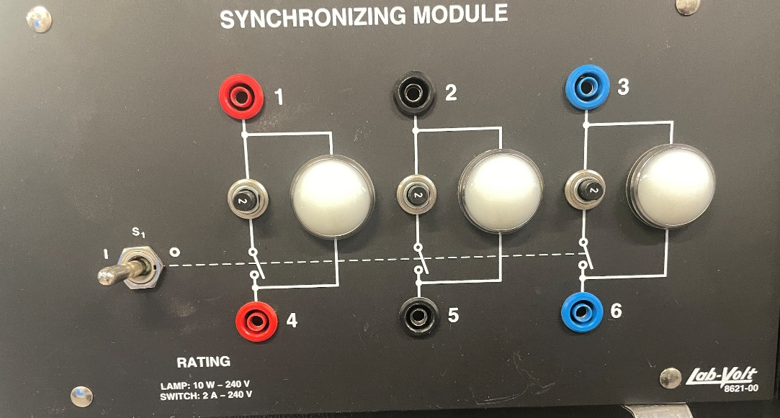
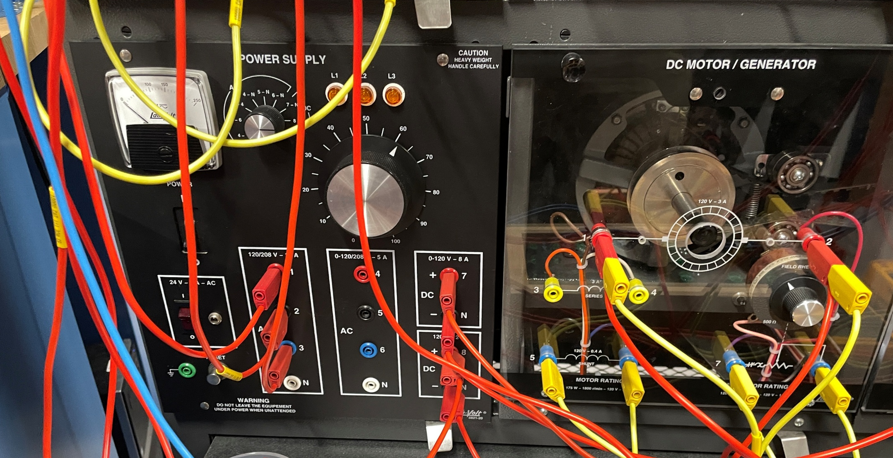
LabVolt Modules
Used both for
Synchronizing
and paralleling
Used to Control Voltage
Used to Control Frequency

Slide 6
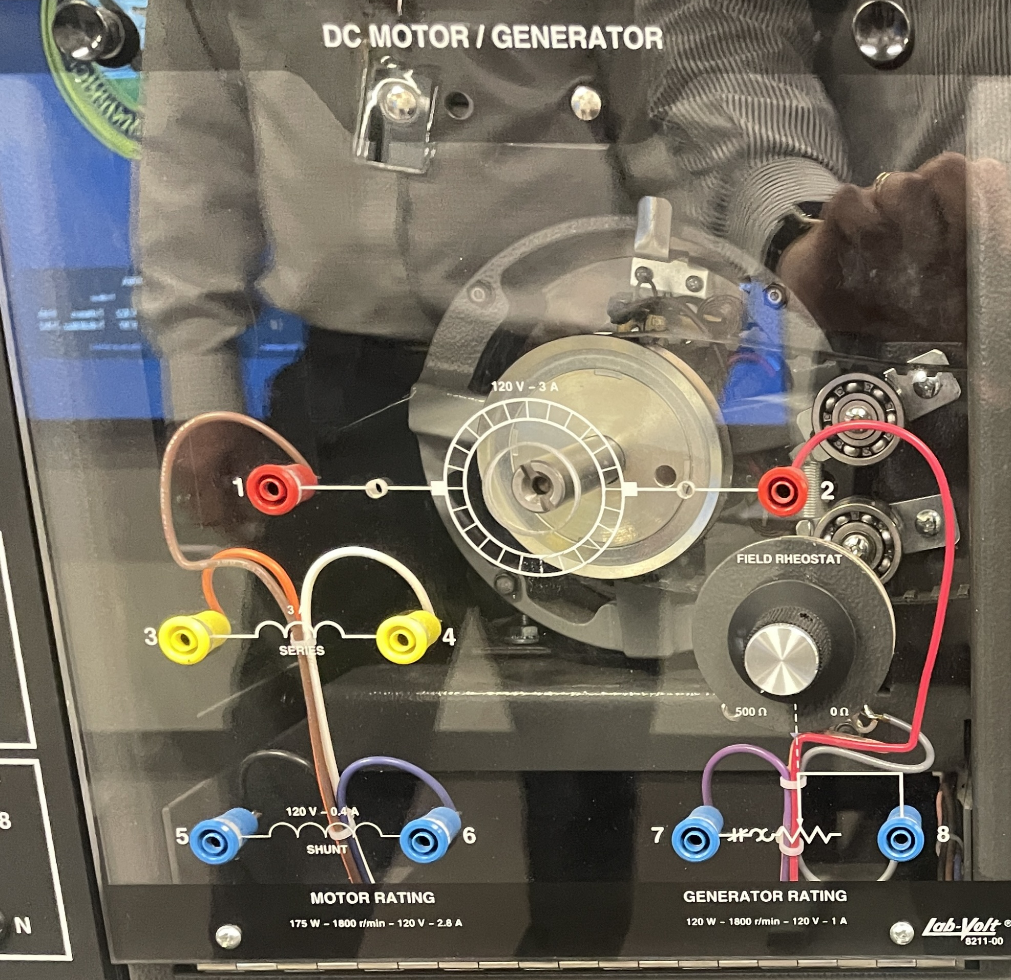
Prime Mover
Modeled by a DC motor
  Constant DC Voltage applied to the Armature (Rotor) {1 and 2}
  Field Rheostat controls current to the Shunt Winding on the stator (Field)
    Shunt winding {5 and 6}
    Field Rheostat {7 and 8}
    Connected in series
      DC voltage {5 and 8}
      Series connection {6 and 7}
Performance
  Normally, Field Rheostat controls the speed of the motor
  With Field Rheostat position fixed
    Speed drops as mechanical load increases
  If motor speed is externally fixed
    Field Rheostat controls amount of power provided to the shaft

Slide 7
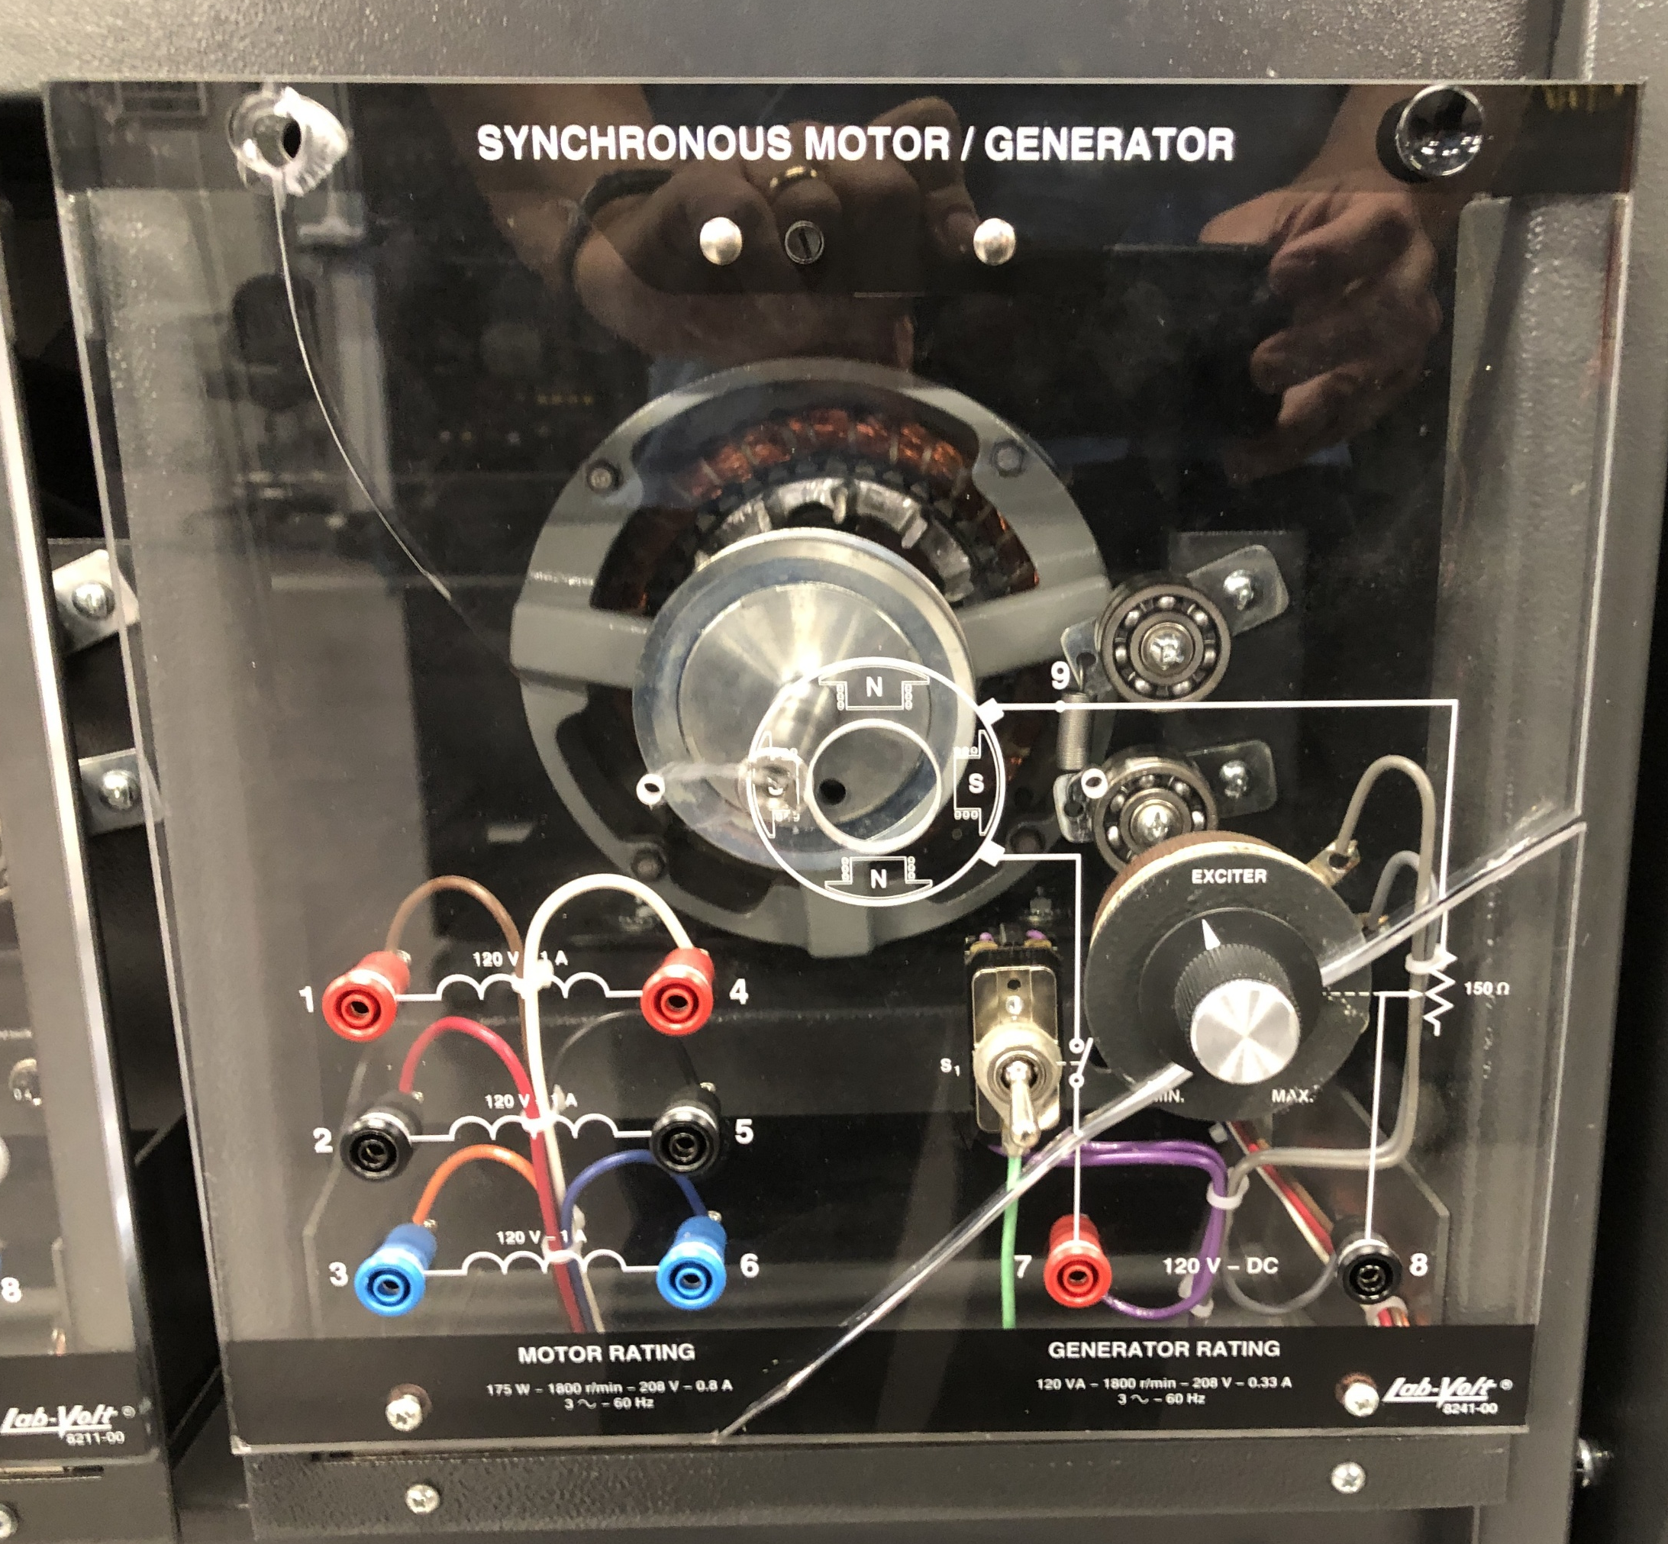
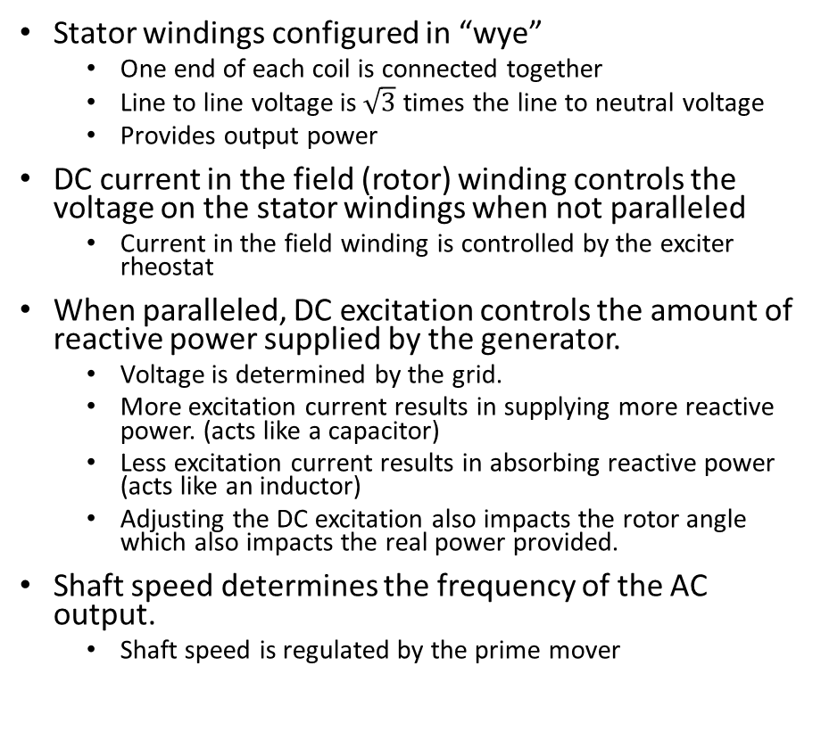
AC Generator
Stator windings configured in “wye”
  One end of each coil is connected together
  Line to line voltage is $\sqrt{3}$ times the line to neutral voltage
  Provides output power
DC current in the field (rotor) winding controls the voltage on the stator windings when not paralleled
  Current in the field winding is controlled by the exciter rheostat
When paralleled, DC excitation controls the amount of reactive power supplied by the generator.
  Voltage is determined by the grid.
  More excitation current results in supplying more reactive power. (acts like a capacitor)
  Less excitation current results in absorbing reactive power (acts like an inductor)
  Adjusting the DC excitation also impacts the rotor angle which also impacts the real power provided.
Shaft speed determines the frequency of the AC output.
  Shaft speed is regulated by the prime mover
Too little excitation current can lead to instability, while too much can cause excessive VAR production.

Slide 8
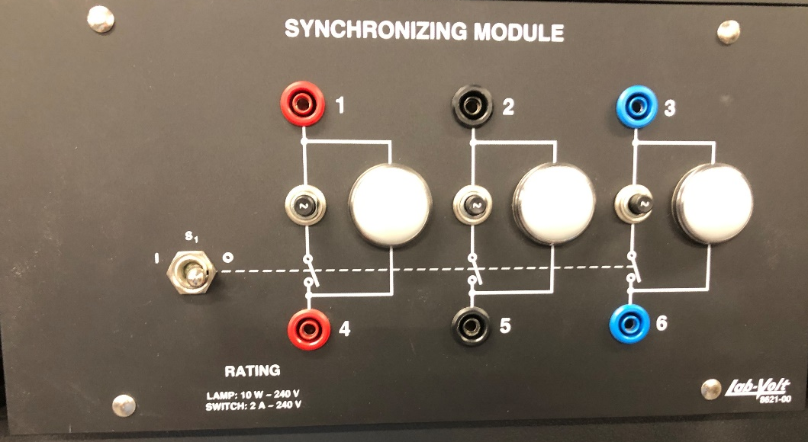
Procedure to Parallel Generator to Shore Power: Three-light method
Adjust Voltage on Generator to be slightly greater than Grid voltage
  Accomplished by adjusting the field rheostat on the AC Generator
Adjust Frequency on Generator to be slightly greater than Grid frequency
  Accomplished by controlling the exciter rheostat on the DC motor
  Goal is for the Generator to take some load when the systems are paralleled
  Avoid reverse powering the motor generator
May have to repeat previous two steps several times
When synchronization lamps are all off, close the paralleling switch
Adjust the rheostat on the DC motor to control amount of power provided by the DC motor … Avoid reverse powering the DC motor
Adjust the rheostat on the AC generator to control the current / reactive power (power factor) provided by the generator

Slide 9
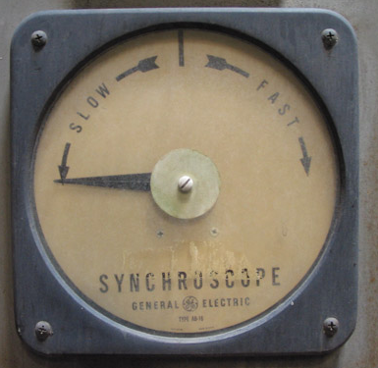
Procedure to Parallel Generator to Shore Power: Synchroscope method
Adjust Voltage on Generator to be slightly greater than Grid voltage
  Accomplished by adjusting the field rheostat on the AC Generator
  Should be no more than 5% higher
Adjust Frequency on Generator to be slightly greater than Grid frequency
  Accomplished by controlling the exciter rheostat on the DC motor
  Goal is for the Generator to take some load when the systems are paralleled
  Avoid reverse powering the motor generator
  Should be less than .067 Hz higher. (15 second period)
May have to repeat previous two steps several times
Synchroscope pointer should be rotating very slowly; when the pointer is almost at the 12 o’clock position, close the paralleling switch. The pointer should be less than 10 electrical degrees from the 12 o’clock position. Need to account for delay in paralleling switch closing.
Adjust the rheostat on the DC motor to control amount of power provided by the DC motor … Avoid reverse powering the DC motor
Adjust the rheostat on the AC generator to control the current / reactive power (power factor) provided by the generator
Picture by DrDreke; Public Domain

Slide 10
Demonstrate what happens if the phase sequences are not the same.
Do not parallel the AC generator with the grid if the AC generator is rotating in the wrong direction.
  Can cause significant damage
  Synchronizing lamps will warn you if this happens – lamps won’t all go out at the same time.
  Synchroscope will NOT indicate a problem.

Slide 11
Other synchronization methods
Permissive Manual Synchronization (synchronism-check device)
How it Works: Synchronization-check device prevents closing the paralleling switch if systems are not in synchronism
Advantages:
  Eliminates human error.
Disadvantages:
  More expensive than purely manual methods.
  Requires additional control circuits and sensors.

Slide 12
Other synchronization methods
Automatic Synchronization (Auto-Sync Relays)
How it Works: Uses microprocessor-based synchronizing relays to automatically match voltage, frequency, and phase angle before closing the circuit breaker. Controls usually provide different options for the level of human operator involvement.
Advantages:
  Eliminates human error.
  Faster and more precise synchronization.
  Can be used in large-scale power plants or renewable energy systems (e.g., wind and solar).
  Commonly found on modern naval ships
Disadvantages:
  More expensive than manual methods.
  Requires additional control circuits and sensors.
Adapted from USNA EE301 Synchronizing 2 Power sources presentation

Slide 13
Wrap Up
For more information, see
IEEE Power System Relaying and Control (PSRC) Committee Working Group J20
April 2024
Practices for Generator Synchronizing Systems
https://www.pes-psrc.org/kb/report/119.pdf

Slide 14
Questions!
Why is it critical to match voltage, frequency, and phase angle before connecting a generator to the grid?
What are the potential risks and consequences of improper synchronization?
How does the synchroscope help in achieving proper synchronization, and why is it preferred over the three-light method in some cases?
Can you think of real-world applications where synchronization is necessary outside of power plants?
What adjustments would you make if the generator’s frequency is slightly higher than the grid’s frequency?
How does excitation influence reactive power, and why does lowering excitation increase active power output?
Questions from USNA EE301 Synchronizing 2 Power sources presentation

Slide 15
Why is it critical to match voltage, frequency, and phase angle before connecting a generator to the grid?
  Mismatched voltage can cause high inrush currents, damaging equipment.
  Mismatched frequency leads to unstable power flow and potential system failure. Protects Equipment:
  Incorrect phase angle results in torque shocks, stressing mechanical components and electrical surges.
What are the potential risks and consequences of improper synchronization?
  Voltage surges leading to insulation breakdown.
  Excessive mechanical stress on generator shafts and turbines.
  Severe power oscillations that could destabilize the grid.
  Tripping of protective relays, causing shutdowns.
How does the synchroscope help in achieving proper synchronization, and why is it preferred over the three-light method in some cases?
  The synchroscope provides a precise and continuous indication of phase difference.
  It clearly shows whether the generator is leading or lagging, aiding in speed adjustments.
  The three-light method is less precise and harder to interpret, especially under fluctuating conditions.
Can you think of real-world applications where synchronization is necessary outside of power plants?
  Synchronizing backup generators to the main power supply in hospitals or data centers.
  Grid integration of renewable energy sources like wind and solar farms.
  Large-scale industrial processes requiring stable multi-generator operations.
  Marine and aerospace applications where multiple power sources operate in parallel.
What adjustments would you make if the generator’s frequency is slightly higher than the grid’s frequency?
  Reduce the prime mover speed slightly to match the grid frequency.
  Fine-tune the generator’s field excitation to balance voltage and frequency.
  Monitor the synchroscope and adjust speed until the needle stabilizes at 12 o’clock.
How does excitation influence reactive power, and why does lowering excitation increase active power output?
Excitation primarily controls reactive power (VARs):
  High excitation → Generator supplies reactive power to the grid.
  Low excitation → Generator absorbs reactive power from the grid.
Why does active power increase when excitation is lowered?
  Lowering excitation causes the generator to absorb reactive power from the grid.
  To maintain synchronism, the rotor angle increases, which raises the active power (kW) output.
  However, too low excitation can lead to instability or loss of synchronization.
Questions from USNA EE301 Synchronizing 2 Power sources presentation

